Slide 1
SOP: MirrorEye MKII ECU Update Process
Brief description of software update process with instructions for both RadMoon and SRI update tool
Current tool version: 0.3.8
04/22/2025

Slide 2
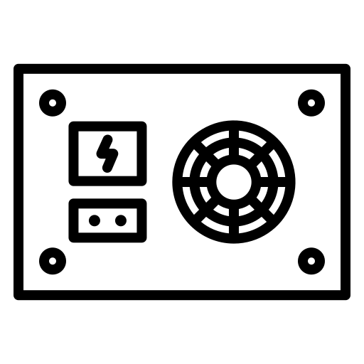

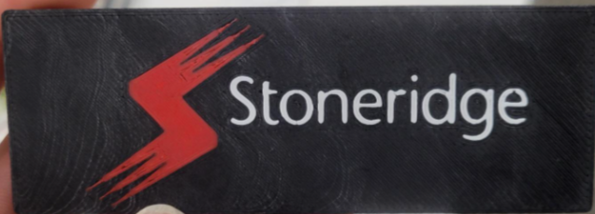
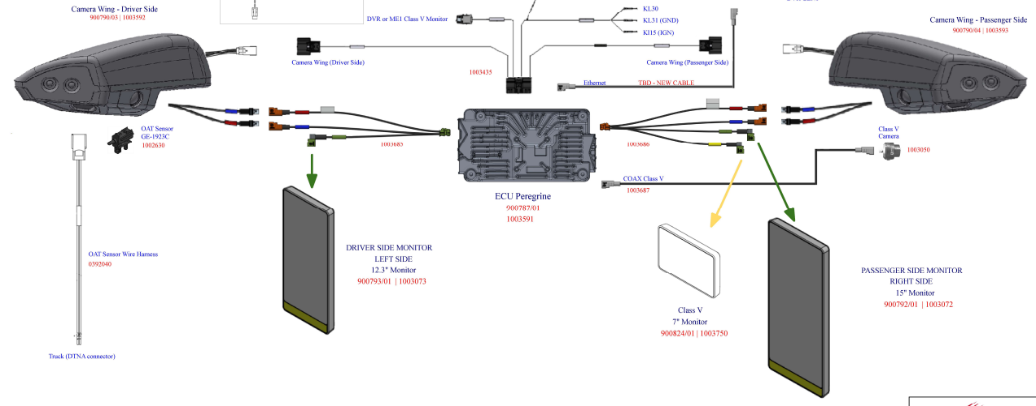
Update Setup
Can be either connectivity device
Components to update ME MKII.
  ME MKII complete system
    ECU;
    2 Wings (left and right);
    Diver Monitor
    Passenger Monitor
    Class V monitor
    Wire Harness
    Fakra Harness
    Power supply/Truck IGN on
  Using Radmoon
    Radmoon tool
    BroadR-Reach cable
    Ethernet & USB cable
    PC with SDM tool
  Using SRI update tool
    SRI SW update tool with attached BRR cable.
    Ethernet & USB cable
    PC with SDM tool
SW Update Tool
Power Supply
12V@10A
RadMoon
12V 12V gnd

Slide 3
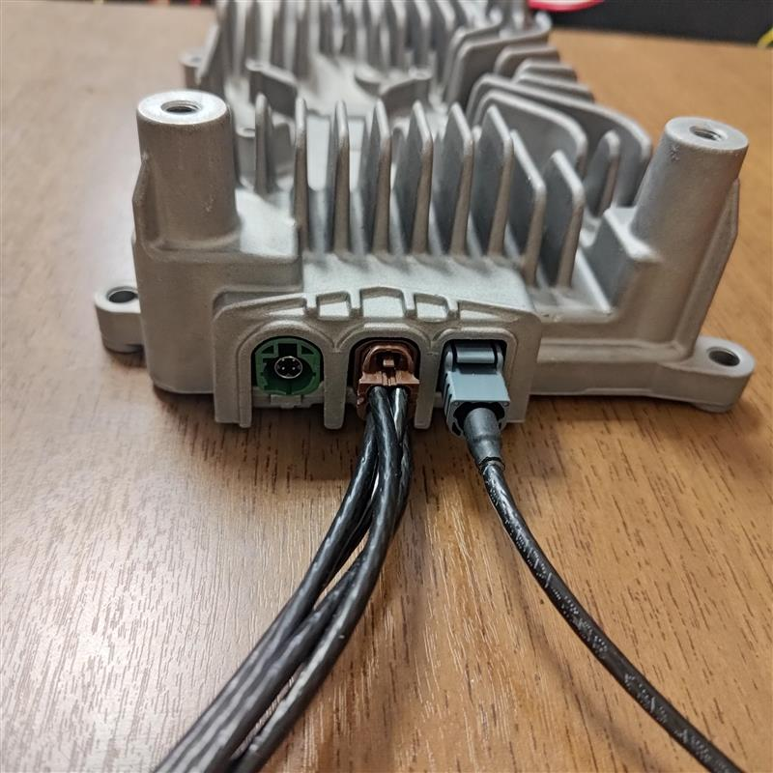
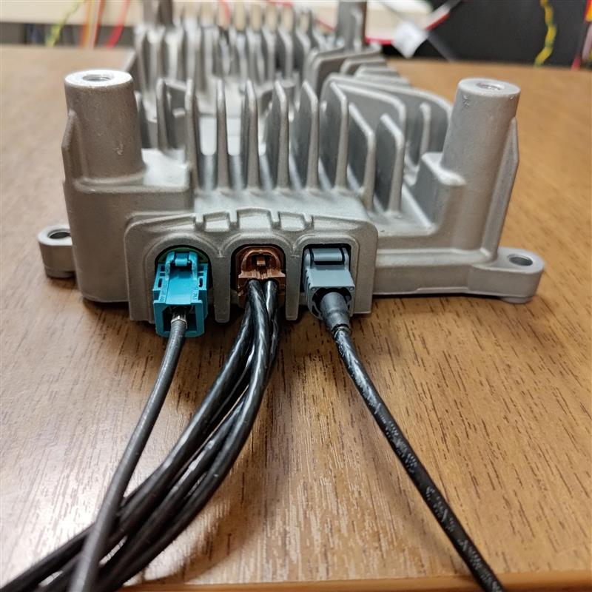

MirrorEye System (MKII) ECU Connections
Update process uses the ethernet port on the left side of the ECU
ECU without optional DVR
ECU with optional DVR

Slide 4
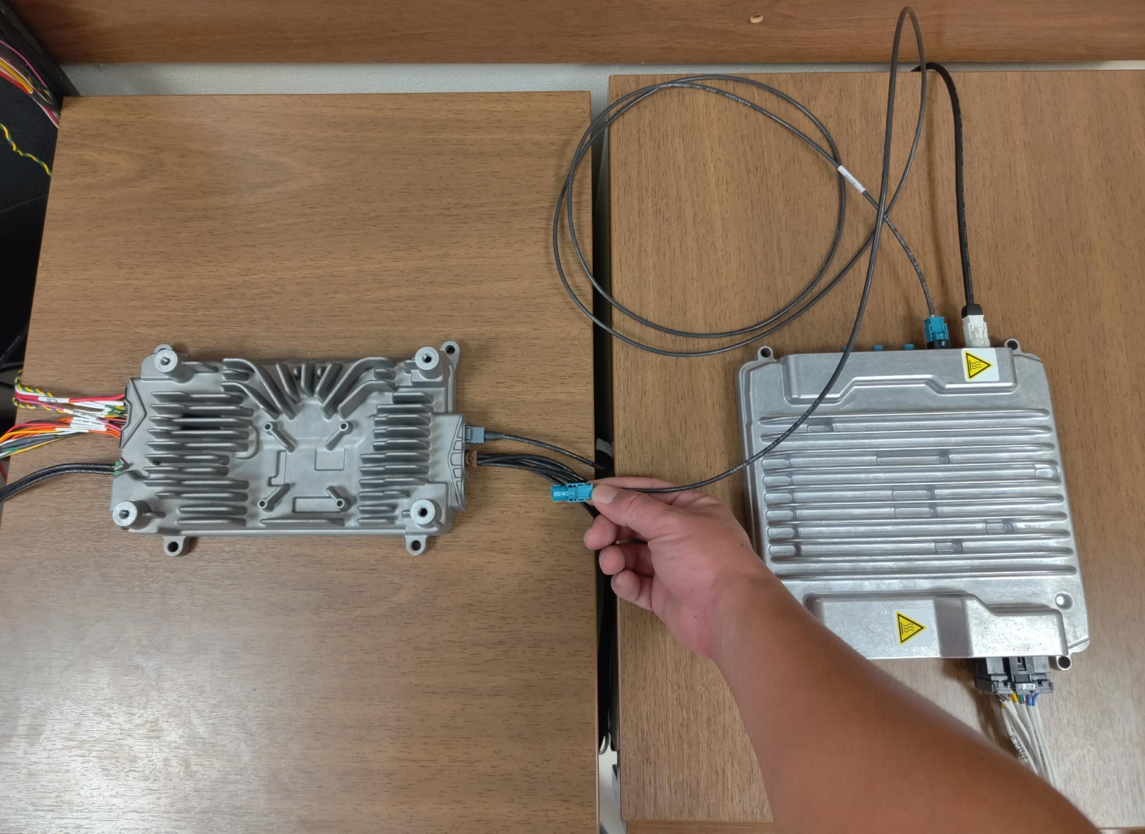


MirrorEye System ECU With Optional DVR Installed
DVR
If the system is equipped with a DVR disconnect the ethernet cable connecting
the DVR from the ECU port

Slide 5
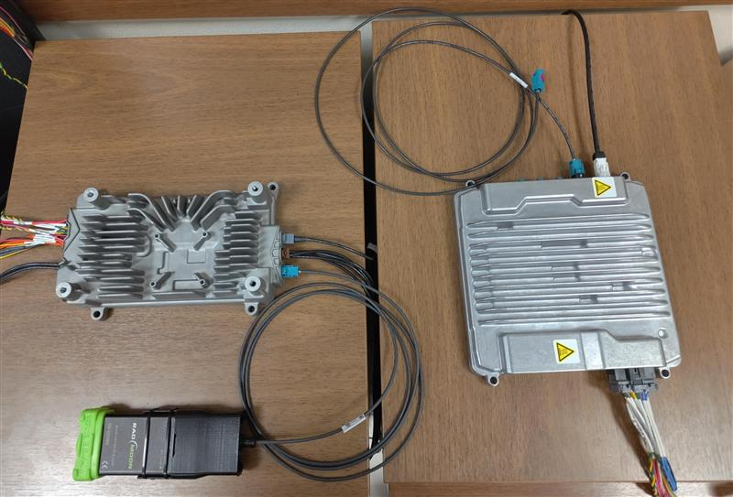
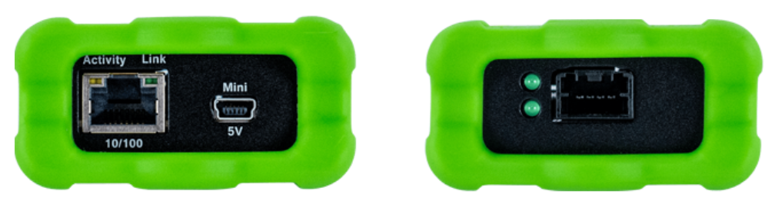
Connection Using Radmoon
Ethernet
Power
Ethernet
To Computer
To ECU
Connect Radmoon to the ethernet port of the ECU and ethernet/power to computer then
launch the SDM Update Tool Application
** Be sure to reconnect DVR when complete for system verification **

Slide 6
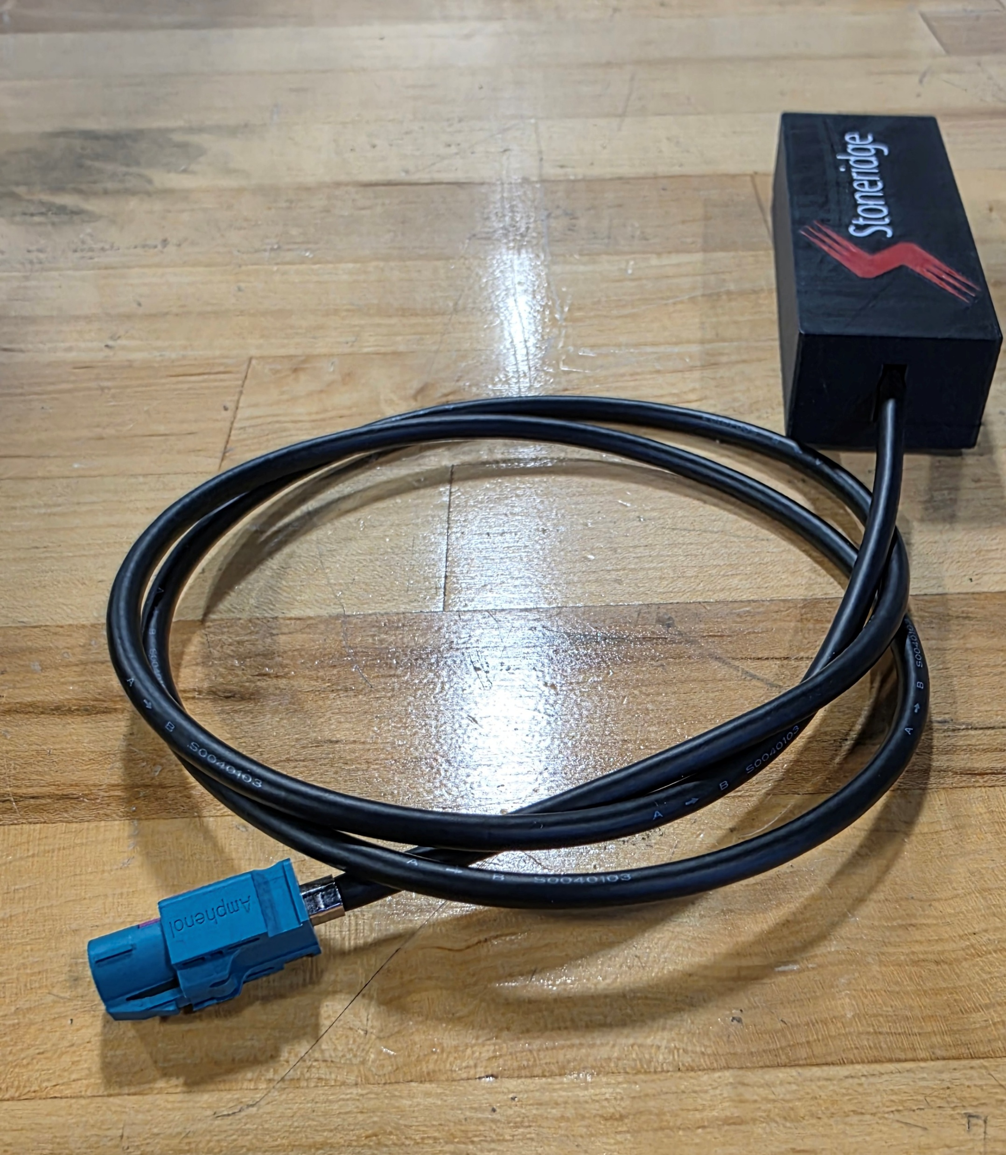
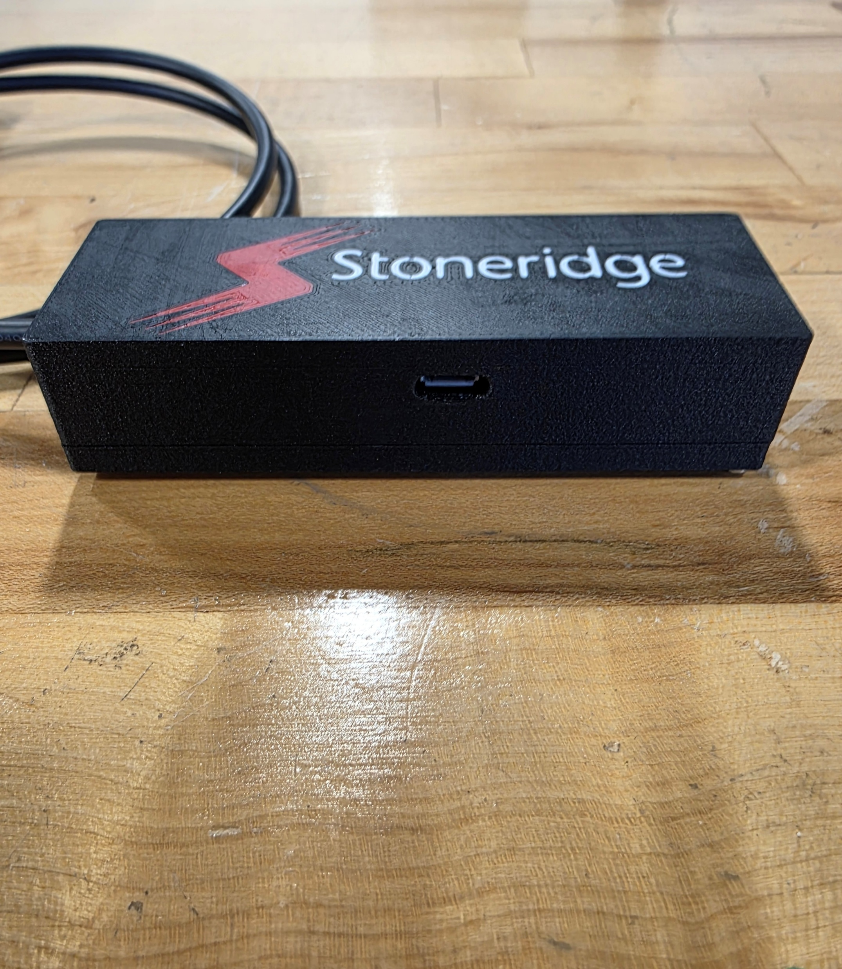
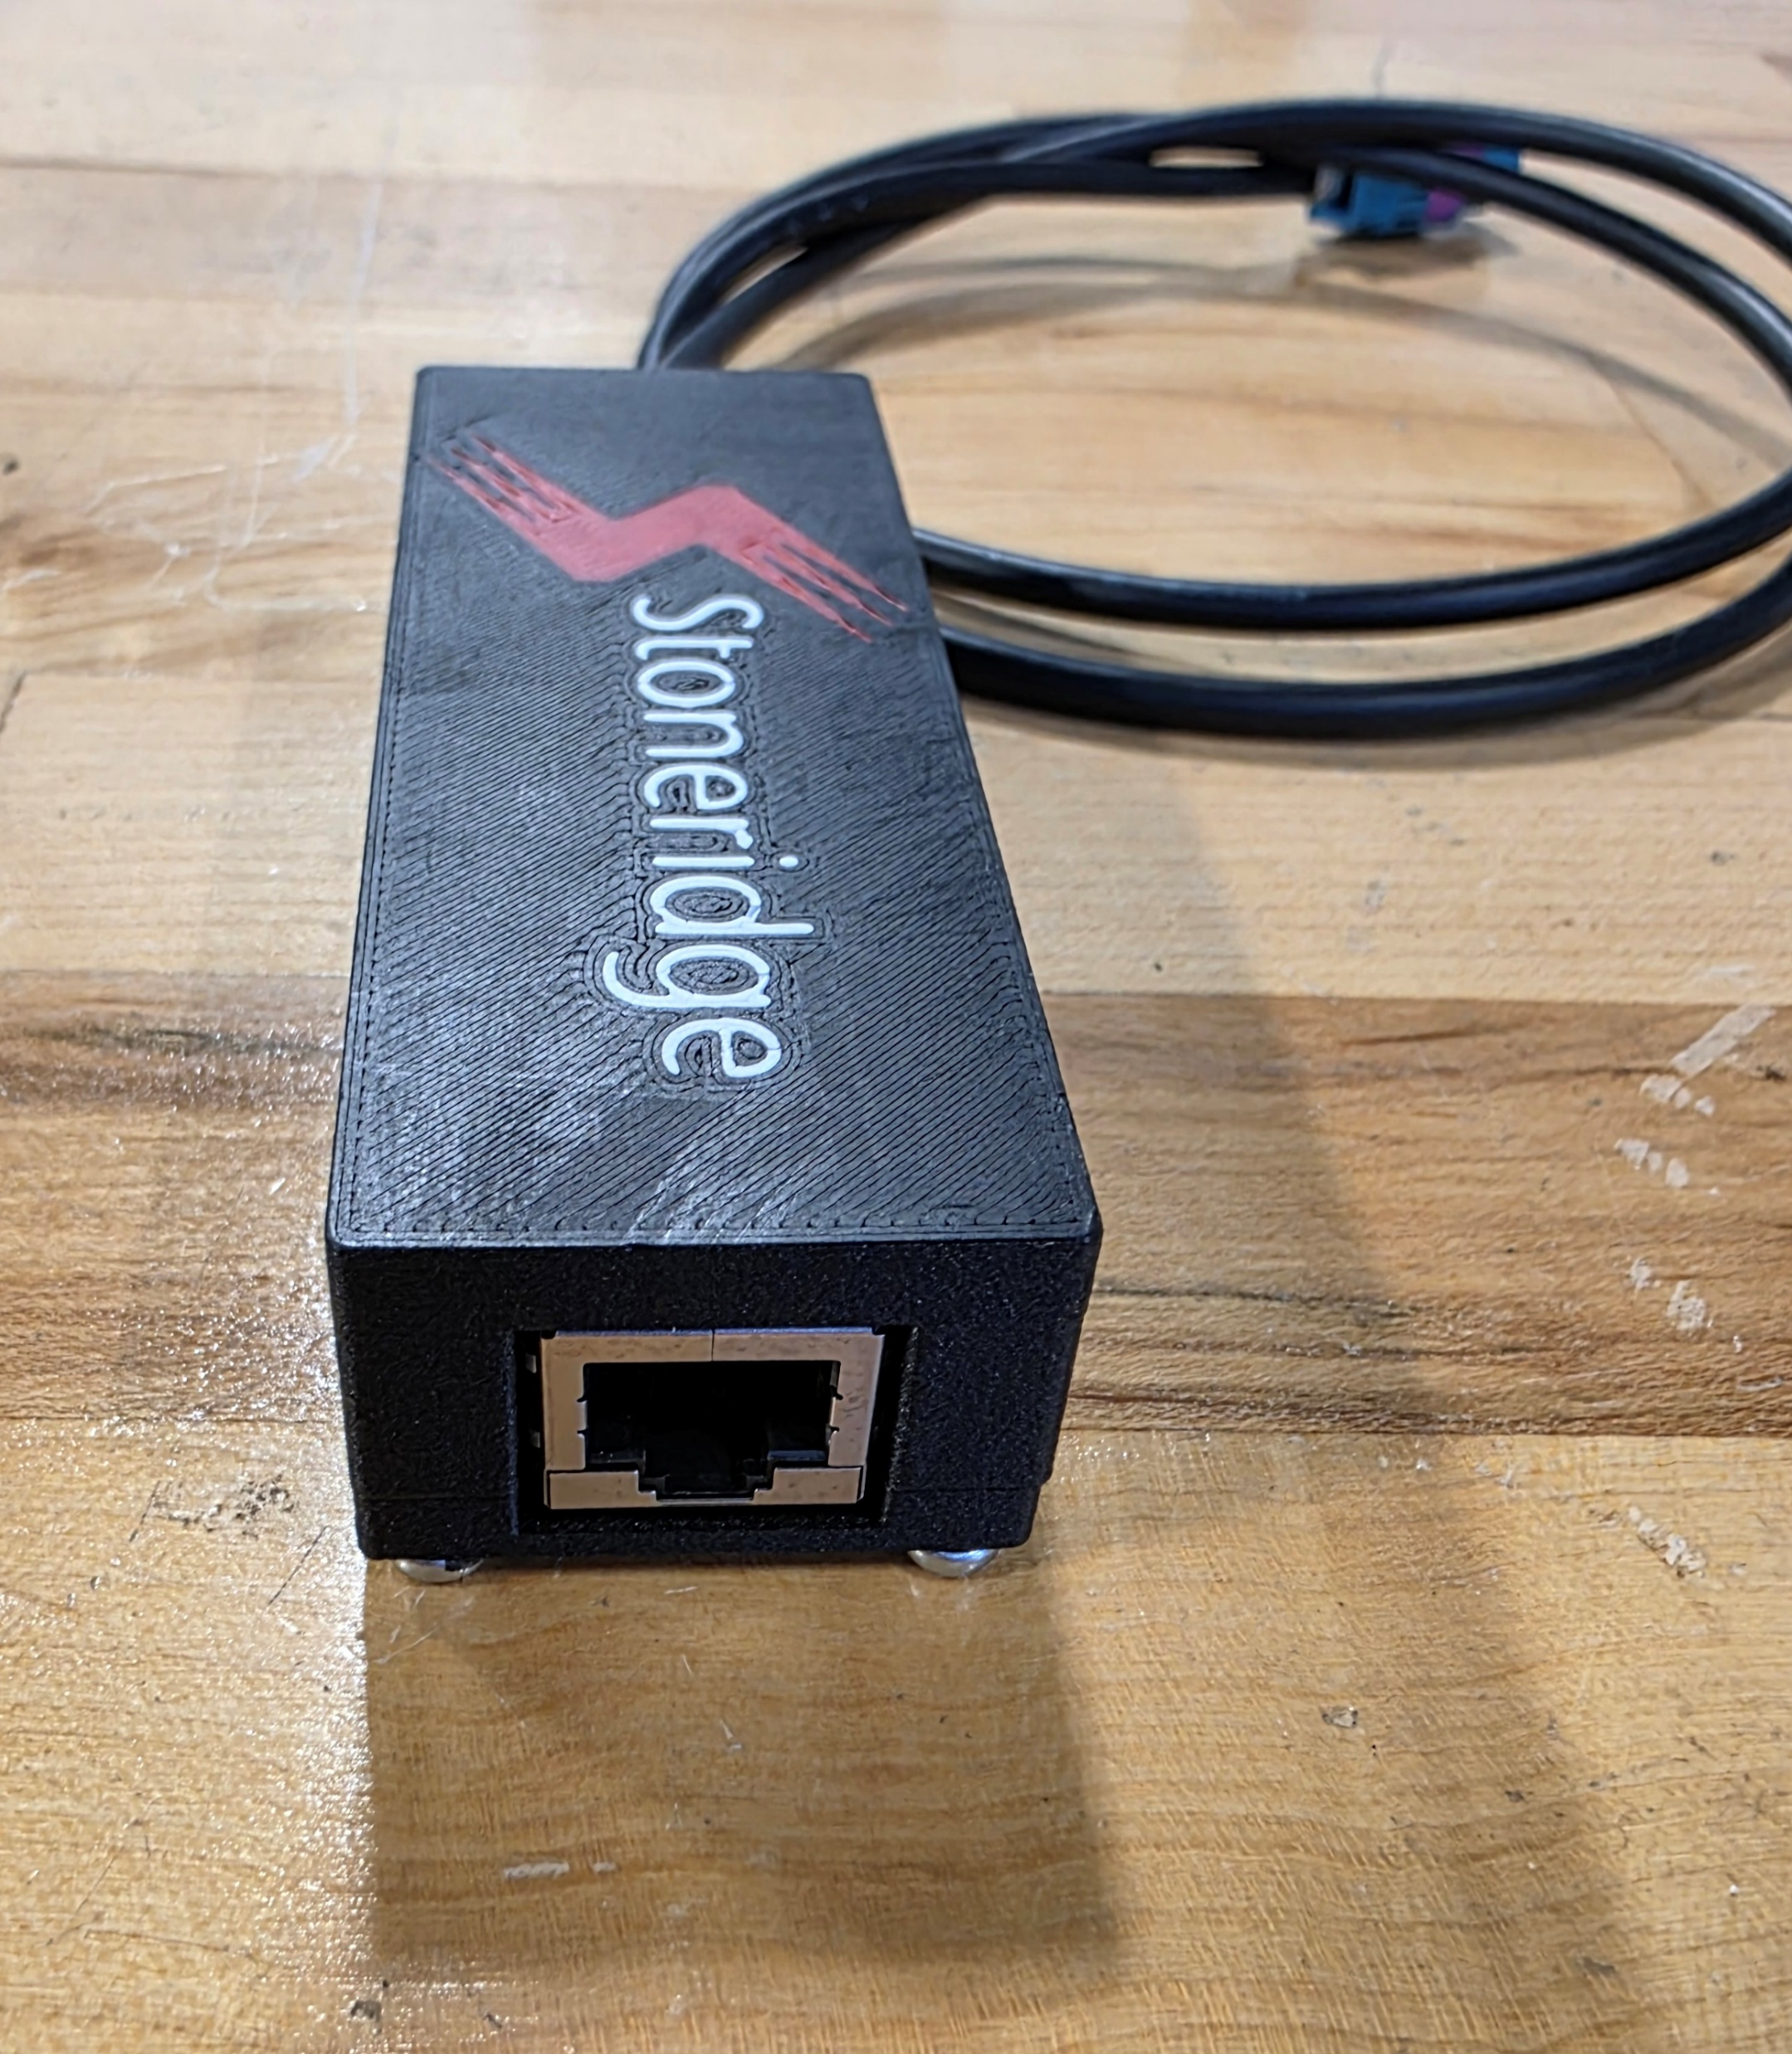
Connection Using SRI Update Tool
Ethernet
To ECU
Power
To Computer
Ethernet
To Computer
Connect SRI update tool to the ethernet port of the ECU and ethernet/power to computer then
launch the SDM Update Tool Application
** Be sure to reconnect DVR when complete for system verification **

Slide 7
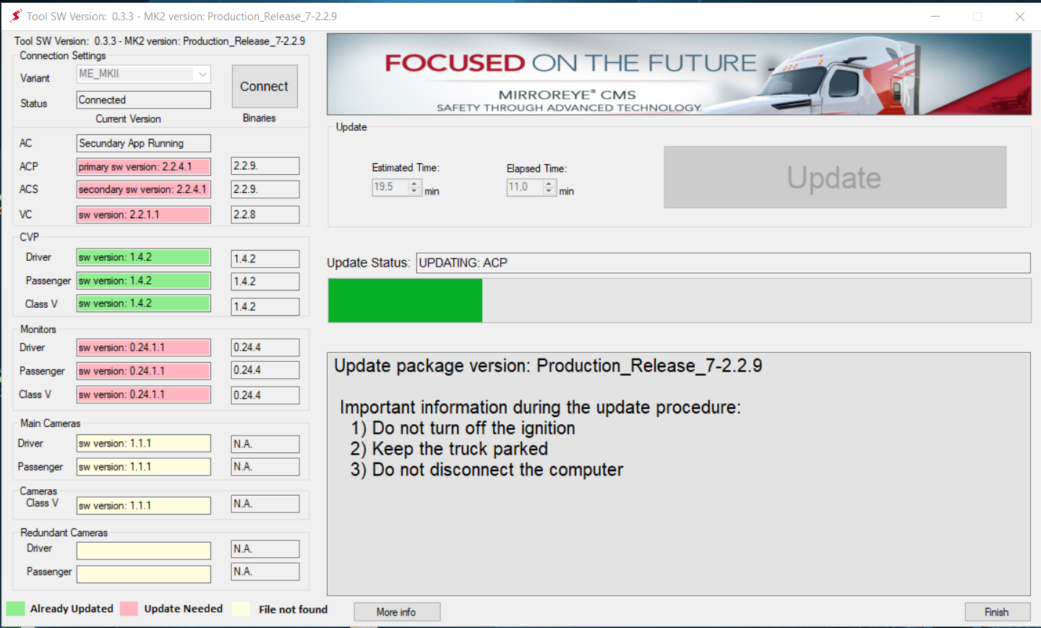
Application Interface
Connect button (should be pressed to stablish ethernet connection with ECU)
Estimated time to update the selected components
Elapsed time to update
Status from ethernet connection
Current components software versions
Button to start the update procedure
Update Status
Components software target versions
Update progress bar
Target MKII SW version
Finish the update
More information about the components (Slide 12)

Slide 8
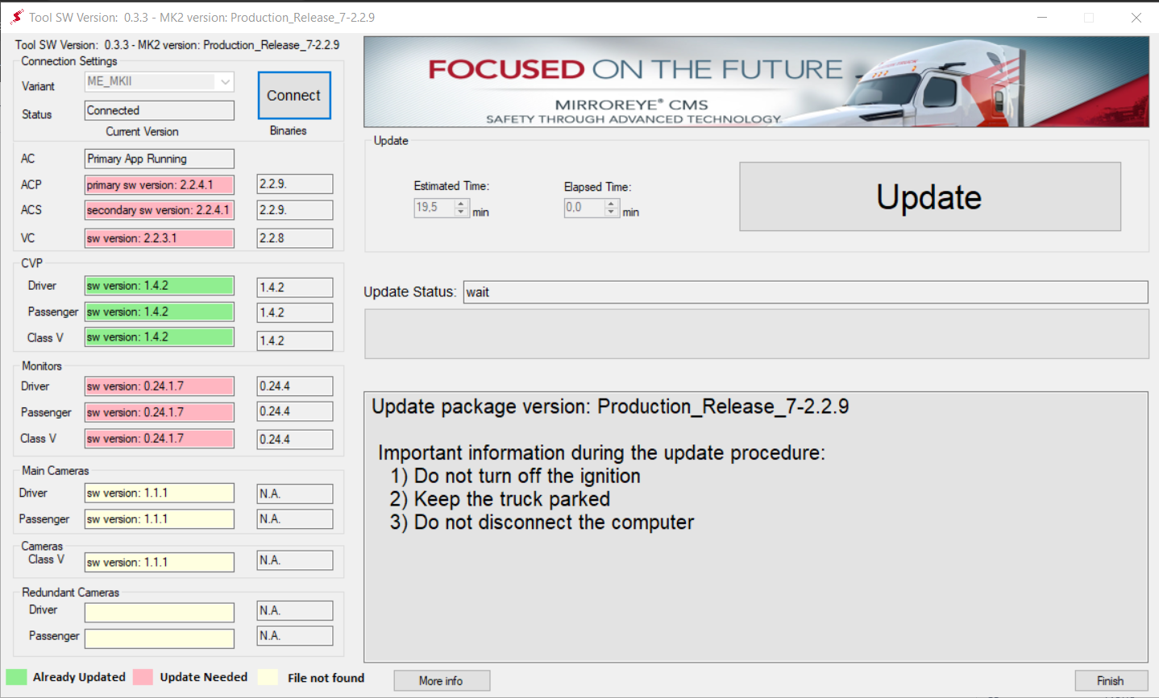
Performing Update
Don’t disconnect the computer from the ECU while the update is running.
Keep the truck parked during the update (Update stop working if the truck is moving).
3
4
5
Run the SDM-ME MKII application
Turn on the ECU and wait 30 seconds
Click connect
Check the estimated time to update
Click update then check the message box that will be displayed on the computer screen
NOTE: If using the black SRI update tool and have errors connecting
See slide 11 for troubleshooting

Slide 9
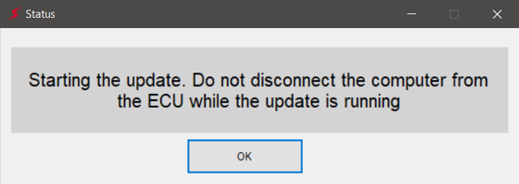
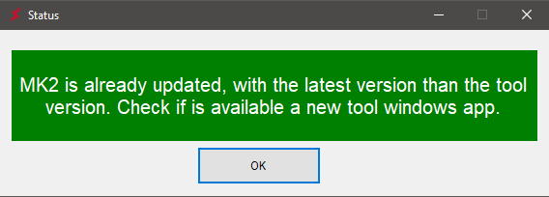
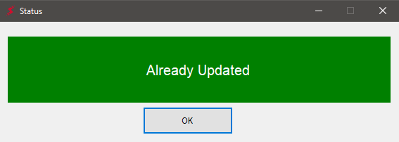
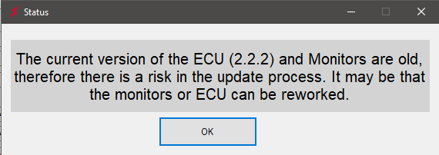
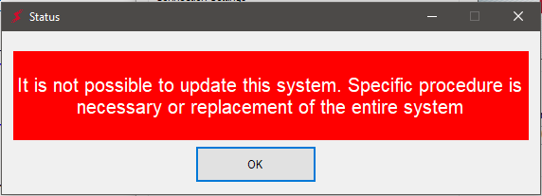
Performing Update
Click OK and continue to the next slide.
6
MK2 is updated with a software version newer than the software version on the currently running application. Verify an ECU update is needed and ensure you are running latest version of application.
6
MK2 is already updated with current software, no need to execute more procedures.
6
The update is possible but there is a risk to execute it, because a tool old version is installed in the ECU and monitors. Press OK and continue to the next slide.
6
The tool is not able to update this MK2 system. An extra procedure is needed. (To do that contact SRE team)
6

Slide 10
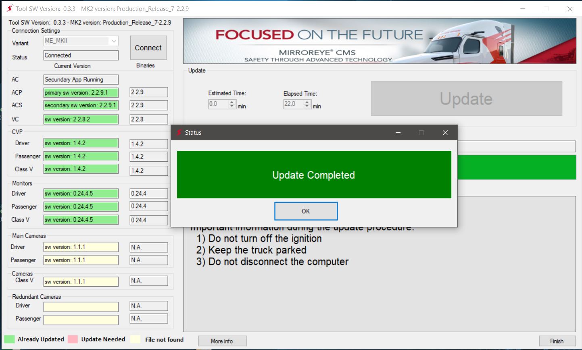
Performing Update
7
The progress bar and the elapsed time can be checked during the update
Wait the message “Update completed”
Click OK
Click Finish.
7
** Be sure to reconnect DVR when complete for system verification **
8
9
10

Slide 11
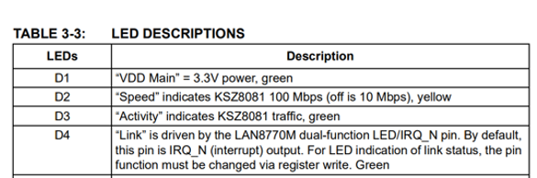
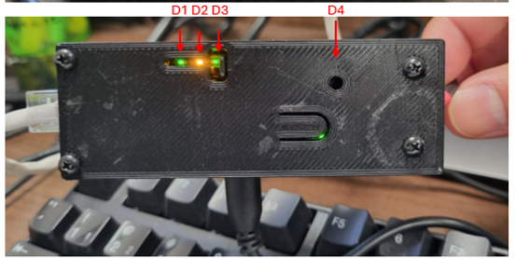
Troubleshooting SRI Update Tool
For successful SW update all LEDs shown in the picture should be on.
D1 is off > verify USB connection, USB should be supplying power to board.
D2-D3 are off > verify Ethernet cable going to PC.
D4 is off > Verify connection to MKII ECU is correct.
Reset button > Press in case the connection got lost, this will reset tool and might recover connection.
Reset button

Slide 12
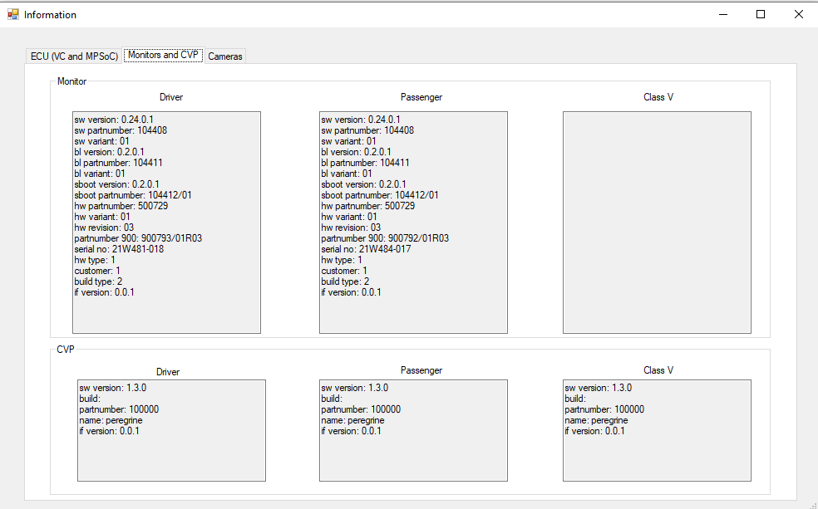
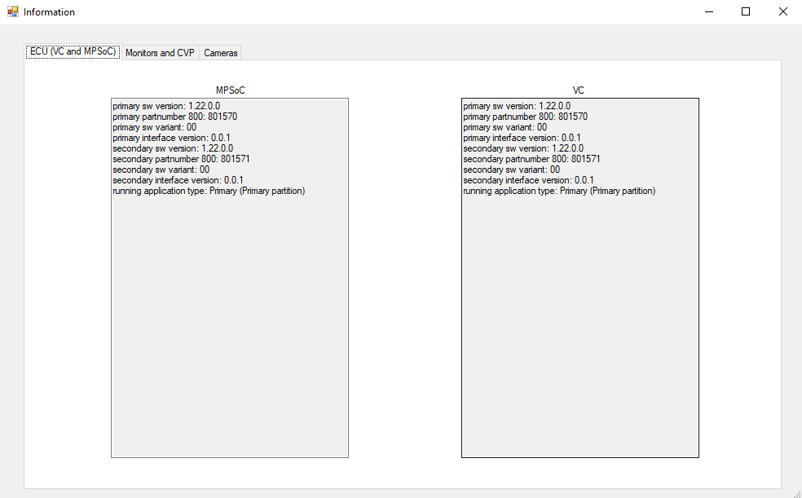
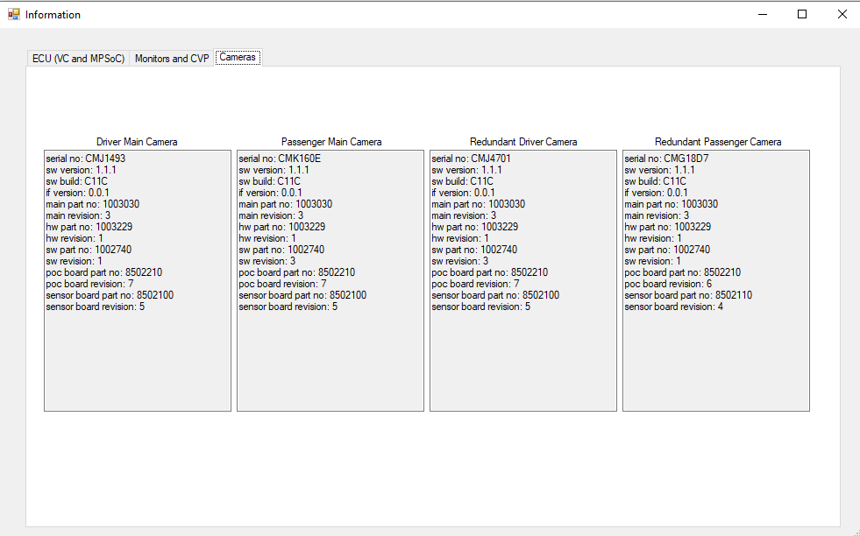
Application Interface: More Info
Feature to display more in-depth information about each ME component.

