Slide 1
Technical Support Resources

Slide 2
How to contact Stoneridge Service Team
Stoneridge Call Center Support - Monday – Friday 8:00 am through 8:00 pm 888-953-9223
Stoneridge Service Portal – File a support ticket
Live chat feature in both My.Stoneridge.app or Stoneridge.app
email Incidents@stoneridge.com

Slide 3
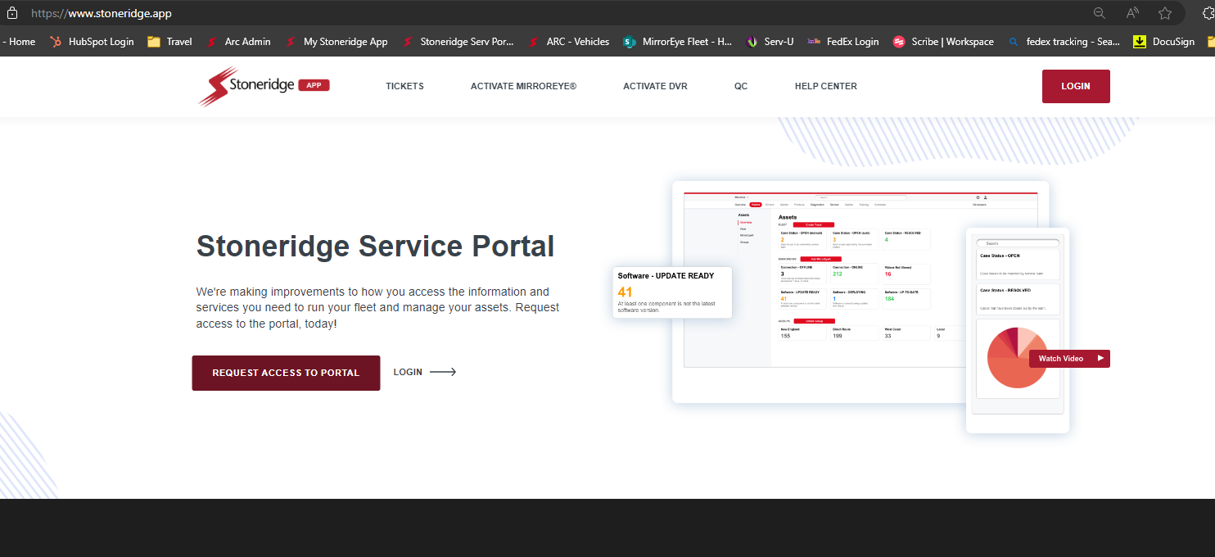
Log in if you already have access
Request Access if you do not have an account

Slide 4
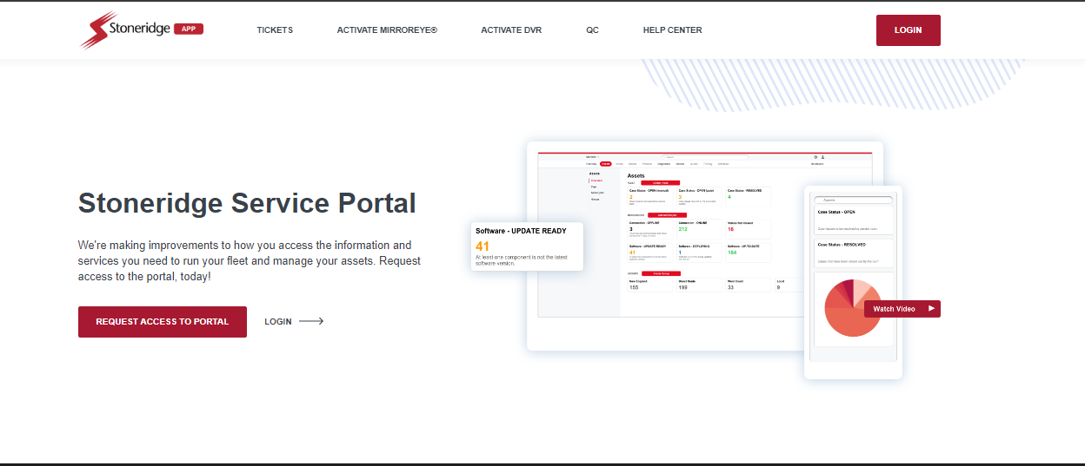
Service Portal URL and Access
Visit: www.Stoneridge.app to set up a portal account and bookmark the site access
Also, download the mobile app for ease of accessing open issues and communicating with the Stoneridge teams

Slide 5
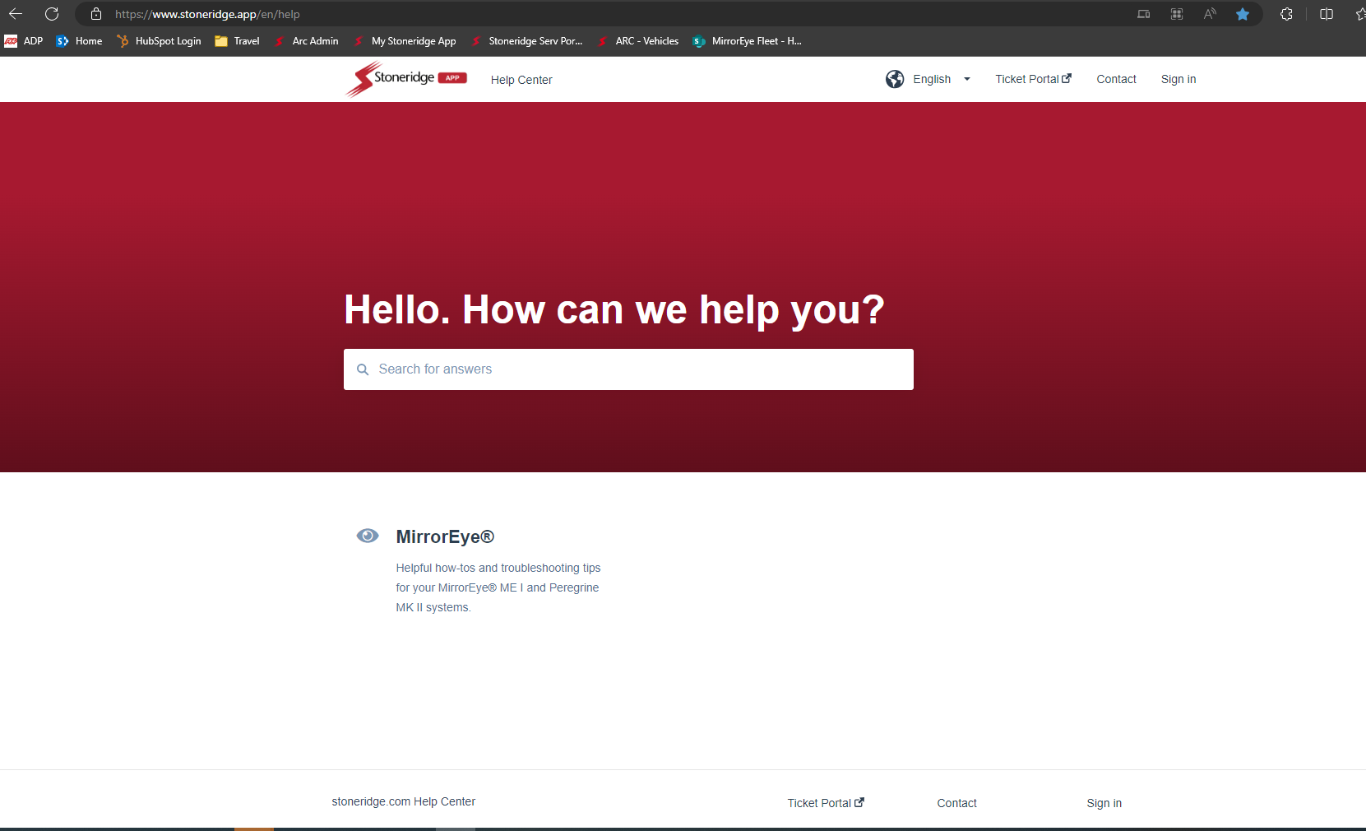
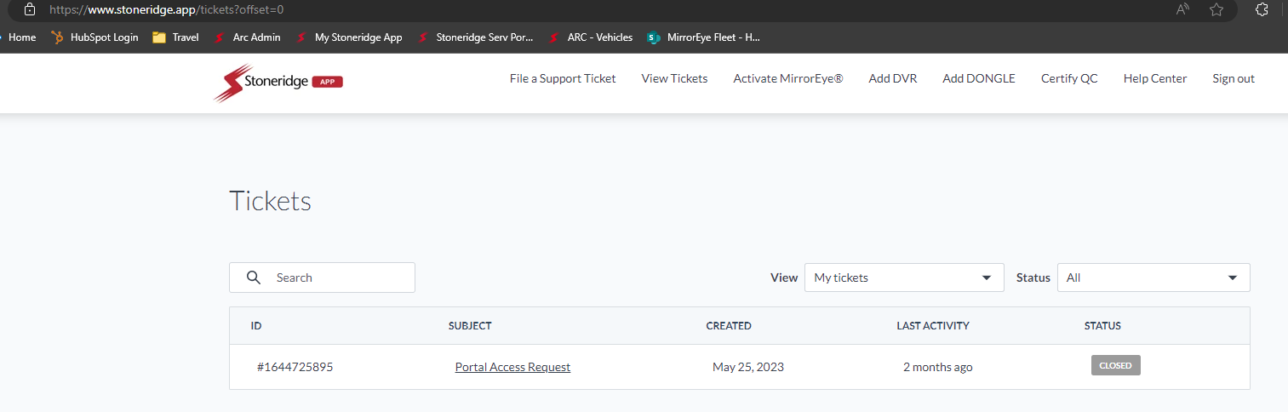
Stoneridge Service Portal
Open a service ticket

Slide 6
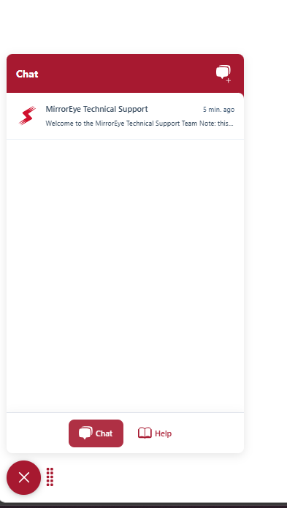
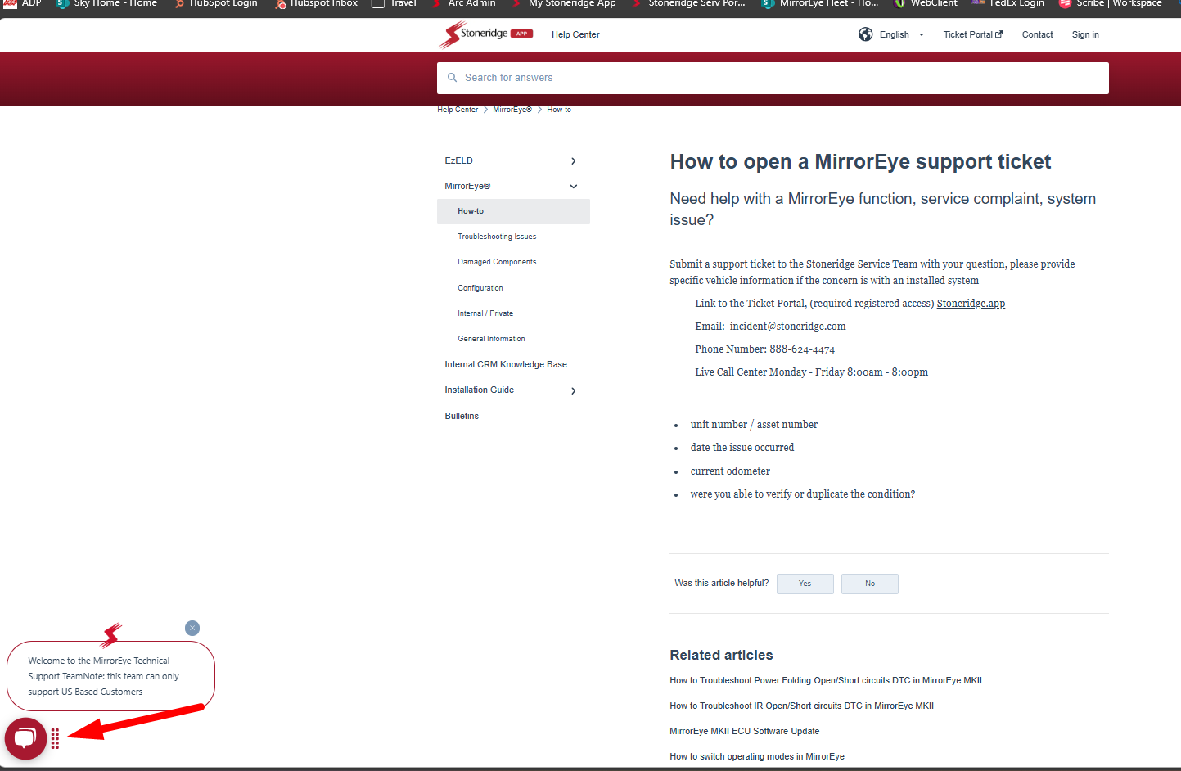
Live Chat in either My.Stoneridge.app or Stoneridge.app
Chat Feature
Tech support
Open / close / update an ongoing
service ticket

Slide 7
Knowledgebase and How To Aricticles

Slide 8
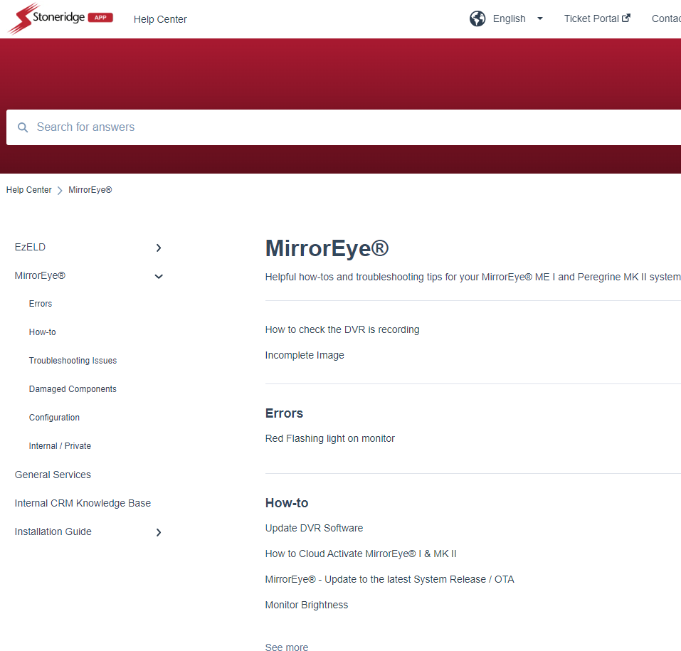
Stoneridge Service Portal
Help Center (stoneridge.app)
Sign in – select MirrorEye section
Errors
How-To
Troubleshooting Issues
Damaged Components
Configuration
Installation Guides

